Slide 1

Snake game
Team Members:-
1. Bittu Kumar
2. Gourav Singh Rathore
3. Mohit Choudhary
4. Juber Khan
5. Dinesh Parmar
6. Manas Agrawal
SAGAR INSTITUTE OF SCIENCE & TECHNOLOGY, GANDHI NAGAR, BHOPAL

Slide 2
Index
Introduction
Software & Hardware Requirement
Problem Description
References
Conclusion
Snake Game Code
Output

Slide 3
Introduction
The following is an example game written in C based on the game called
'snake' which has been around since the earliest days of home computing (I
can remember writing a version of it for my ZX81), and has re-emerged in
recent years on mobile phones
It isn't the world's greatest game, but it does give you an idea of what you
can achieve with a relatively simple C program, and perhaps the basis by
which to extend the principles and create more interesting games of your
own.

Slide 4
Software & Hardware Requirement
Software Requirements.
The development and deployment of the application requires the following general and specific
minimum requirements for software:
• Programming Language Translator- C
•IDE- Jupyter Notebook
•Operating System used Windows 11.
Hardware requirements.
The development and deployment of the application requires the following general and specific
minimum requirements for hardware:
•Processor- (32-bit or 64-bit)
•RAM (4 GB)

Slide 5
Problem Description
Snake can move in a given direction and when it eats the food, the length of snake increases. When snake crosses itself, the game will over. Food will be generated at given interval.

Slide 6
Conclusion
This project in C language of Snack Game is a simple console
Application with very simple graphics. In this project, you can play the popular “Snack Game” just like you played elsewhere .you have to use the up, down , left, right or left arrows to move the snack.
Food are provided at the several co-ordinates of the screen for the snake to eat . Every time the snack eats the food ,its length will by increased by one element along with the score.

Slide 7
References
https://en.Wikipedia.org/wiki
http://WWW.Youtube.com
https://www.cs.bham.ac.uk
Books
a. lets us c by Yashwant kanetkar
b. programming with C by E balagurusamy

Slide 8
Below is the C program to build the complete snake game:
// C program to build the complete
// snake game
#include <conio.h>
#include <stdio.h>
#include <stdlib.h>
#include <unistd.h>
int i, j, height = 20, width = 20;
int gameover, score;
int x, y, fruitx, fruity, flag;
// Function to generate the fruit
// within the boundary
void setup()
{
gameover = 0;

Slide 9
// Stores height and width
x = height / 2;
y = width / 2;
label1:
fruitx = rand() % 20;
if (fruitx == 0)
goto label1;
label2:
fruity = rand() % 20;
if (fruity == 0)
goto label2;
score = 0;
}

Slide 10
// Function to draw the boundaries
void draw()
{
system("cls");
for (i = 0; i < height; i++) {
for (j = 0; j < width; j++) {
if (i == 0 || i == width - 1
|| j == 0
|| j == height - 1) {
printf("#");
}
else {
if (i == x && j == y)
printf("0");
else if (i == fruitx
&& j == fruity)
printf("*");
else
printf(" ");
}
}
printf("\n");
}

Slide 11
// Function to take the input
void input()
{
if (kbhit()) {
switch (getch()) {
case 'a':
flag = 1;
break;
case 's':
flag = 2;
break;
case 'd':
flag = 3;
break;
case 'w':
flag = 4;
break;
case 'x':
gameover = 1;
break;
}
}
}

Slide 12
// Function for the logic behind
// each movement
void logic()
{
sleep(0.01);
switch (flag) {
case 1:
y--;
break;
case 2:
x++;
break;
case 3:
y++;
break;
case 4:
x--;
break;
default:
break;
}

Slide 13
// If the game is over
if (x < 0 || x > height
|| y < 0 || y > width)
gameover = 1;
// If snake reaches the fruit
// then update the score
if (x == fruitx && y == fruity) {
label3:
fruitx = rand() % 20;
if (fruitx == 0)
goto label3;
// After eating the above fruit
// generate new fruit
label4:
fruity = rand() % 20;
if (fruity == 0)
goto label4;
score += 10;
}
}

Slide 14
// Driver Code
void main()
{
int m, n;
// Generate boundary
setup();
// Until the game is over
while (!gameover) {
// Function Call
draw();
input();
logic();
}
}

Slide 15
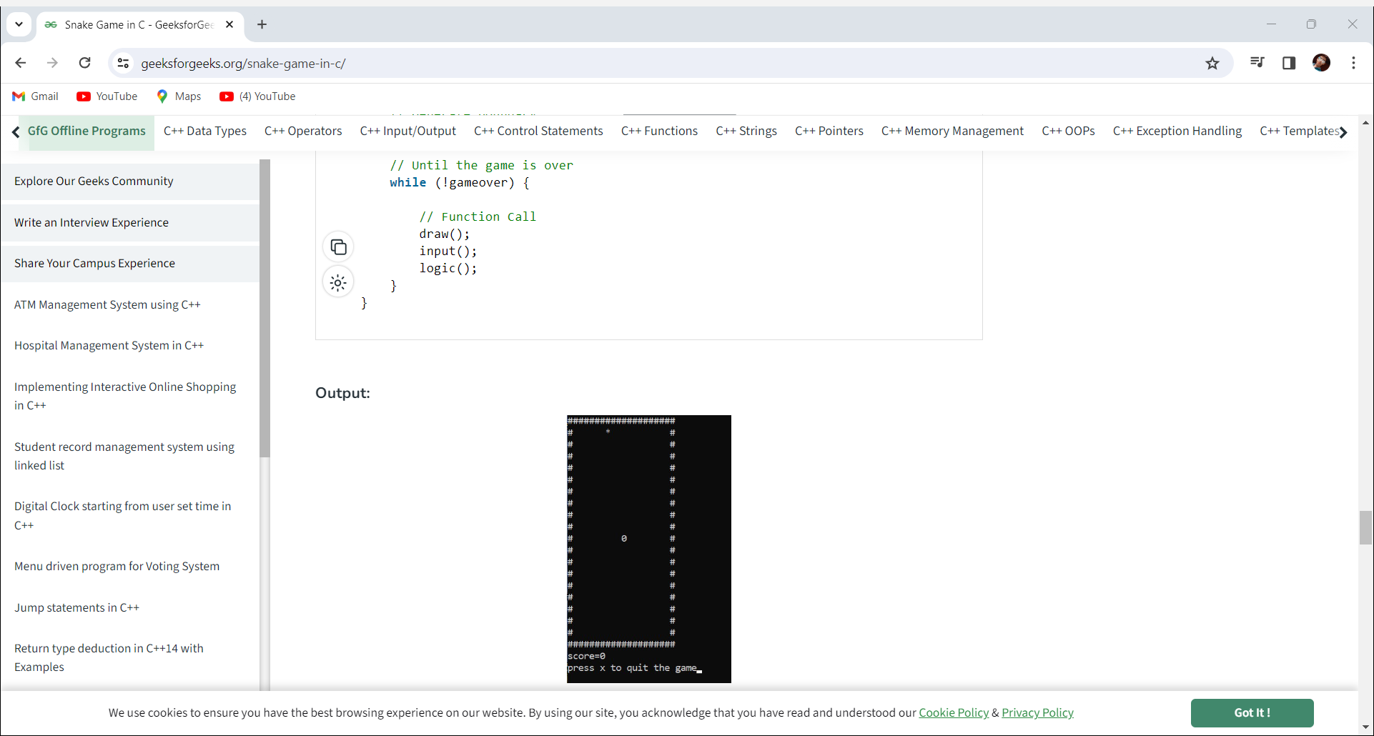

Slide 16
THANK YOU

